Slide 1
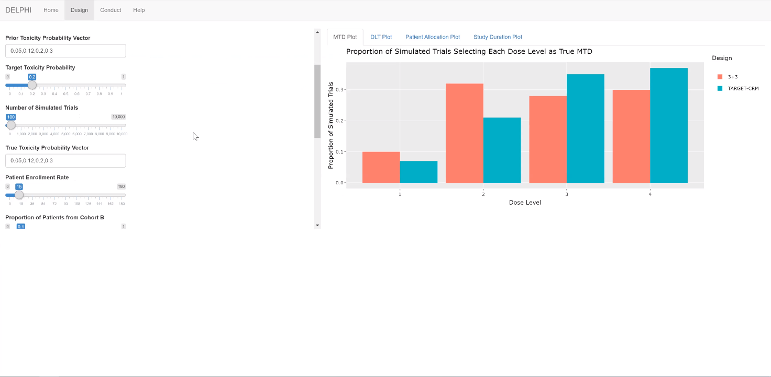
Current Layout

Slide 2
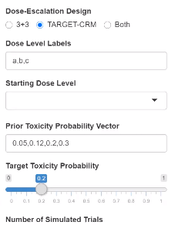
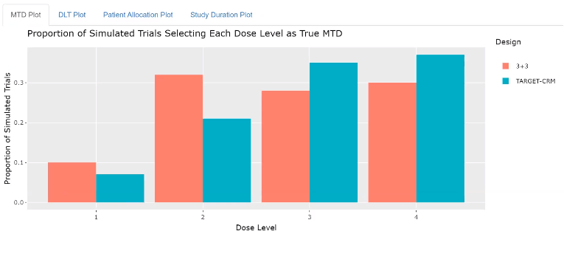
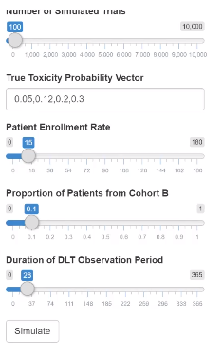
Option 1: Add Input Table / Details
Input Variable | Current Value
Dos Escalation Design | Both
Dose Level Labels | A, B, C
…. | …
… | …
Other Details Here

Slide 3
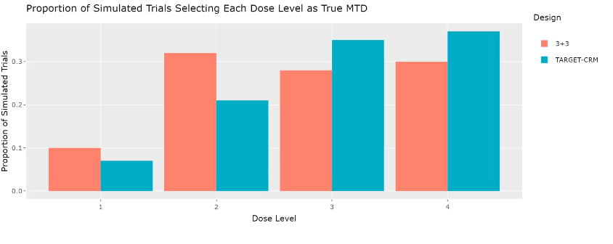
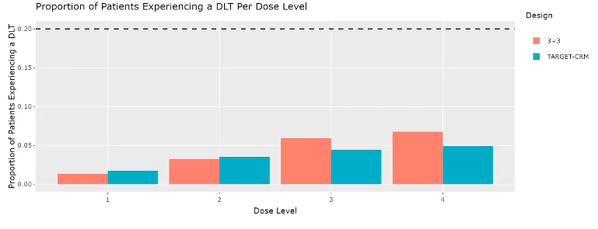
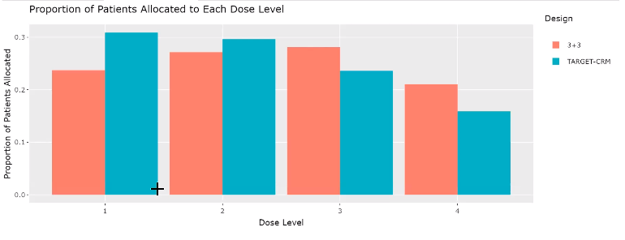
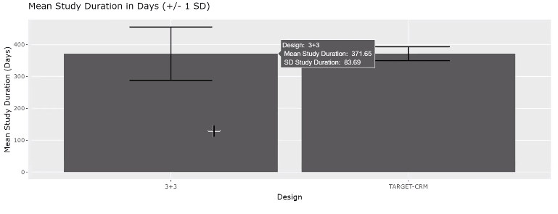
User can click on an individual chart to expand to single page expanded view with additional details
Option 1: 2x2 (no tabs)
Simulation Results
Input Variable | Current Value
Dos Escalation Design | Both
Dose Level Labels | A, B, C
…. | …
… | …
Other Details Here

Slide 4
Option 3: Input parameters separate from Results
Design Tab displays this screen first.
User inputs parameters and then clicks simulate.
Results are displayed on next screen.

Slide 5
Option 3: Input parameters separate from Results
Input Parameters
User clicks here to modify inputs and re-run simulation
User can click on an individual chart to expand to single page expanded view with additional details
Simulation Results
Input Variable | Current Value
Dos Escalation Design | Both
Dose Level Labels | A, B, C
…. | …
… | …
Other Details Here

